Slide 1

Process Mining Virtual Internship
by
M.CHARAN BABU
Roll No. 204G1A3211
Department of Computer Science and Engineering (Data Science)
Srinivasa Ramanujan Institute of Technology
(Affiliated to JNTUA & Approved by AICTE) (Accredited by NAAC with ‘A’ Grade & Accredited by NBA (EEE, ECE & CSE)
Rotarypuram Village, B K Samudram Mandal, Ananthapuramu – 515701.
2023 - 2024

Slide 2
Contents
Course objective
Introduction
Technology
Applications
Modulations
Real Time Applications
Learning outcomes
Github link
Queries

Slide 3
Contents
Course Objective:
The course explains the key analysis techniques in process mining. Participants will learn various process discovery algorithms. These can be used to automatically learn process models from raw event data. Various other process analysis techniques that use event data will be presented.
Process mining applies data science to discover, validate and improve workflows. By combining data mining and process analytics, organizations can mine log data from their information systems to understand the performance of their processes, revealing bottlenecks and other areas of improvement.

Slide 4
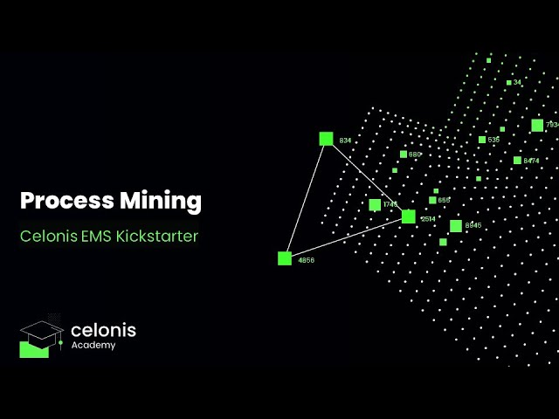
Introduction
Process mining applies data science to discover, validate and improve workflows. By combining data mining and process analytics, organizations can mine log data from their information systems to understand the performance of their processes, revealing bottlenecks and other areas of improvement.
Process mining is a technique that uses data from computer systems to understand home work processes happen in real life. It helps organizations find ways to improve these processesby analysing the data and identifying areas where things could be done more efficiently or effectively.
At its core, process mining leverages event logs and data collected from various information systems, such as enterprise resource planning (ERP) systems, customer relationship managementCRM) systems, and workflow management tools

Slide 5
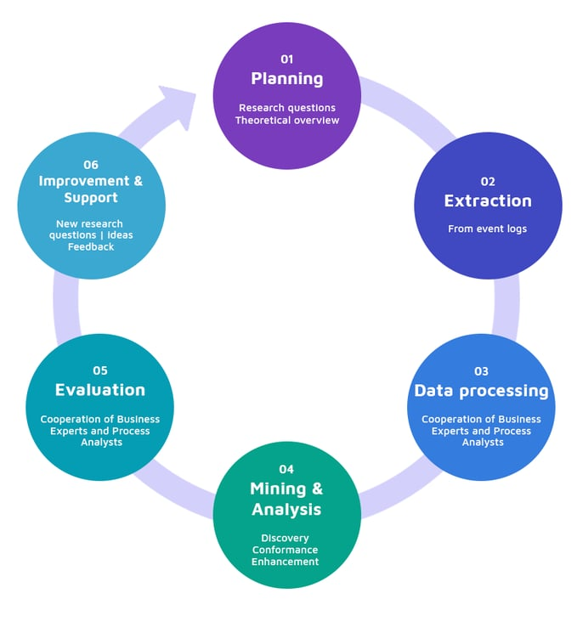
Steps for Process Mining
There are 6 steps involved in process mining:
Planning
Extraction
Data Processing
Mining and Analysis
Evaluation
Improvement And Support

Slide 6
Steps for Process Mining
Planning:
A process mining project starts with selecting the business processes to be analysed and improved, ideally formed around a research question. Research questions can be related to different aspects, e.g. quality, time, resource, cost.
Extraction:
Data Extraction describes the extraction of data from a system. In the context of process mining, this means that event data is extracted from an IT system to perform a Data Transformation and analysis.
Data processing:
The main objective of this stage is to create event logs as different views of the obtained event data and to process event logs in a way that is optimal for the mining and analysis stage
Mining and Analysis:
In this stage process mining techniques are being applied on event logs and aim to answer research questions and gain insight into process performance and compliance
Evaluation:
By diagnosing the findings, it is established if the results were interpreted correctly and interesting results are being distinguished from expected ones.
Improvement and Support:Process mining provides operational support by detecting problematic running cases, predicting their future or suggesting recommended actions

Slide 7
Technology
Process mining utilizes a combination of techniques and technologies to analyse event logs and extract insights from processes. Here are the key technologies involved in process mining:
1. Event Log Data:
Event logs are at the core of process mining. These logs record various events, activities, and interactions in a structured format, usually with timestamps.
2. Data Collection and Integration:
APIs (Application Programming Interfaces): APIs are used to collect data from different systems and integrate it into a unified format for analysis.
ETL (Extract, Transform, Load) Tools: ETL tools help in extracting data from various sources, transforming it into a suitable format, and loading it into a central repository.
3. Process Enhancement Tool:
these tools are suggest process improvements based on analysis results,aiding in making informed decidions aboout hoe to streamline and optimization process
4.Process Visualization:
Process modelling notations like BPMN (Business Process Model and Notation) are used to visually represent process flows. Visualization libraries and tools help in creating interactive and informative visualization of process data.

Slide 8
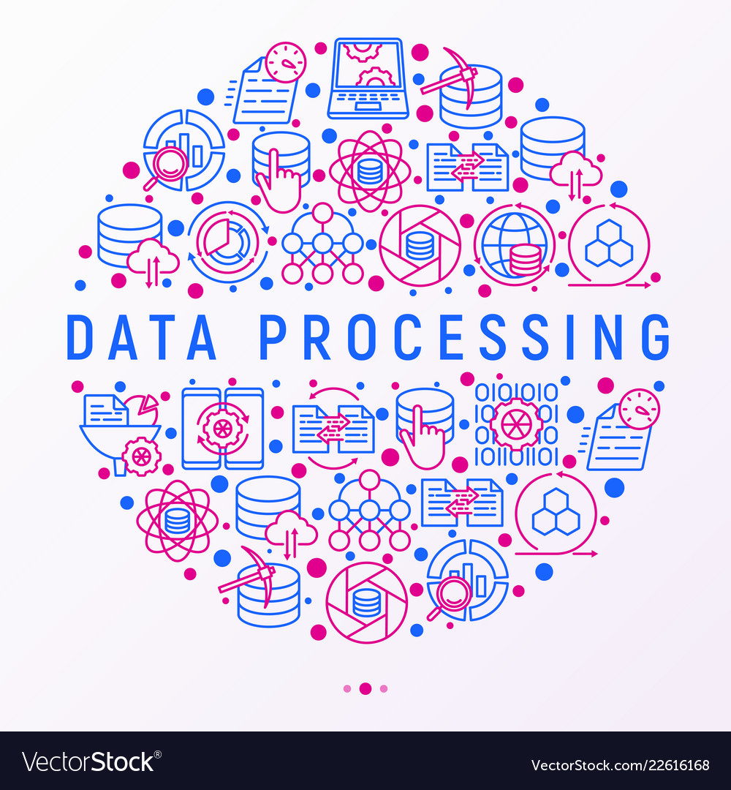

Technology
5.Machine Learning and AI:
Machine learning algorithms can be applied for predictive analytics, anomaly detection, and clustering in process mining. AI techniques enhance process discovery, conformance checking, and performance prediction
6.Cloud Computing:
Cloud platforms such as AWS, Azure, and Google Cloud offer scalable infrastructure for storing and processing large volumes of data.

Slide 9
Applications
Buisness Process Reengineering:
Oraganizations can redesign process based on process mining insights,leading to more efficent and effective workflows.
Healthcare:
In healthcare, process mining can be used to analyze patient care pathways, identify areas for reducing waiting times, and optimize hospital workflows. It can also assist in complying with regulations and enhancing patient safety.
Information Technology (IT) Management:
IT departments can use process mining to analyze IT service management processes, identify incidents, and optimize response times. It also aids in tracking changes and managing the IT infrastructure more efficiently
Predictive Analytics:
By analyzing historical data,process mining can predict future processs behaviour and help organizations proactively adress issues.

Slide 10
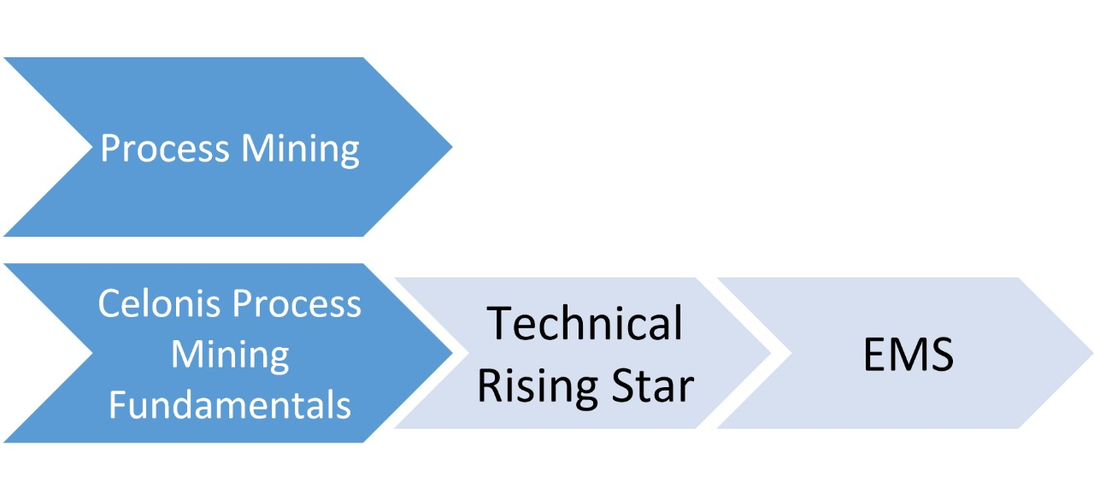
Modules
process mining
celonis process mining fundamentals
technical rising star
EMS

Slide 11
Process Mining Fundamentals
Process Mining Fundamentals:
Process mining involves analyzing event data to gain insights into processes.
Its fundamentals include:
Data Extraction: Collecting event logs from IT systems that record process-related
activities.
Preprocessing: Cleaning and transforming raw data into a suitable format for analysis.
Process Discovery: Creating process models (e.g., flowcharts, Petri nets) from event logs
to visualize process flows.
Conformance Checking: Comparing discovered models with actual data to identify deviations
and compliance issues.
Enhancement: Iteratively improving process models based on analysis results and expert knowledge

Slide 12
Execution Management Consulting For Students
specific institution or organization using this term to get a clear understanding of what it entails in the context of process mining and its application to students.
Education and Training: Students should receive training and education in process mining concepts, techniques, and tools. This can be done through coursework, workshops, online resources, and tutorials.
Hands-On Experience: Practical experience is crucial. Students can work on real-world case studies, participate in process mining competitions, or collaborate with organizations to analyze their processes and identify improvements.
Consulting Projects: Students can engage in consulting projects where they work with real organizations to apply process mining techniques. This could involve analyzing process data, identifying bottlenecks, suggesting optimizations, and presenting findings to the organization.
Collaboration with Experts: Students should connect with experienced professionals in the field of process mining. This could be through networking events, conferences, or mentorship programs.

Slide 13
Real Time Examples
Telecommunications: Customer Service Analysis
Telecommunication companies can use process mining to analyze customer service interactions. By tracking customer inquiries, support requests, and resolution processes, they can identify pain points in real time.
Financial Services: Loan Application Processing
Banks and financial institutions can use process mining to analyze the loan application process. By tracking the various stages of application review, document verification, and approval, they can identify bottlenecks and areas where the process is taking longer than necessary.
Manufacturing Industry: Production Line Optimization
Using process mining, a manufacturing company can analyze data from sensors and equipment on their production line. By visualizing the flow of materials, identifying bottlenecks, and analyzing deviations from standard procedure.
Healthcare Sector: Patient Journey Analysis
Hospitals can utilize process mining to analyze the patient journey, from admission to discharge. By tracking events like patient interactions, test results, and treatment processes, healthcare providers can identify delays, redundancies, and potential areas for improvement in real time.
Logistics: Freight Tracking and Optimization
Logistics companies can leverage process mining to track the movement of freight in real time. By analyzing data from GPS trackers, shipment records, and warehouse operations, they can identify the most efficient routes, optimize delivery schedules, and reduce transit times

Slide 14
Learning Outcomes
After completion of this task I learnt about basic knowledge of Process Mining
Steps of process mining.
Technologies that involved in Process Mining.
Applications and Real Time Examples.

Slide 15
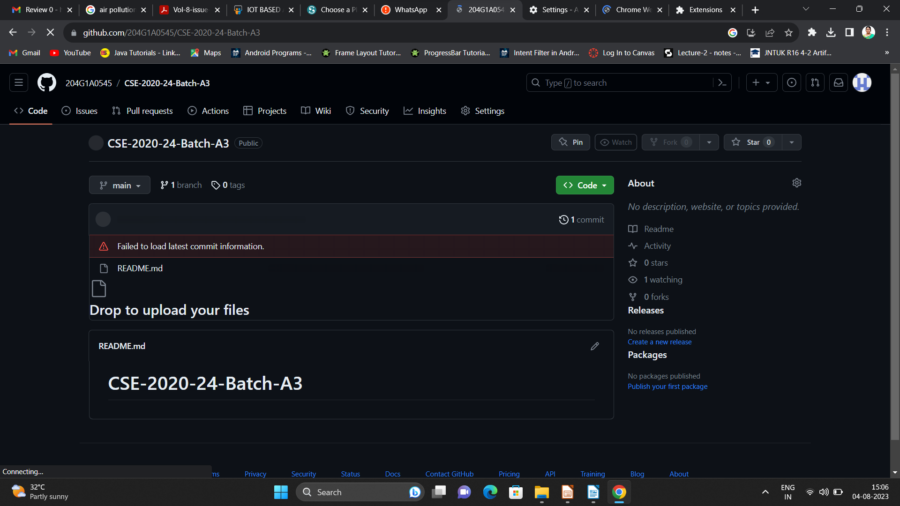

Git Hub Dashboard
Repository Name Like: Summer Internship - I
Under that include document, presentation and Certificate(Pdf).

Slide 16
Any Queries?

Slide 17
Thank You!!!

